Slide 1
LOGO
Nulogy RFP Support
The information here may be used in your RFP bids to help win new co-pack business. Some slides have been designed without Nulogy branding to allow you to paste them into your own branded sales slides.
Notes:
Welcome to our RFP Support deck, which was created to equip you with the information and messaging needed to communicate the benefits of being Powered by Nulogy in new business opportunities.
Please refer to the speaker notes for additional details about communicating your Nulogy investment to potential new clients.

Slide 2
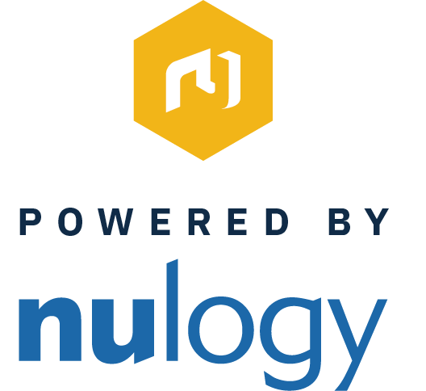
LOGO
Today’s suppliers of choice are able to meet the needs of their customers with responsiveness and excellence.
In order to compete in today’s market, top-tier suppliers are powered by best-of-breed solutions.
[name of company] is Powered by Nulogy.

Slide 3






LOGO
Why We Chose Nulogy
A purpose-built solution for co-packing, supported with continuous innovation
Proven in hundreds of successful deployments globally
20+ years of professional services expertise in co-packing environments, with deep understanding of best practices and workflows
Trusted by major FMCG brands including Mars, Nestlé, P&G, L’Oréal, Colgate, and Church & Dwight
Robust global support, consulting, and training capabilities to ensure effective change management and our team’s ongoing success
Notes:
Slide notes:
Introduce Nulogy as your technology partner of choice for deliver superior co-packing service: “Our operations are digitally powered by a trusted technology vendor that provides the following benefits…”

Slide 4
How Nulogy Enhances Our Operation
LOGO
KEY MESSAGES TO POSITION NULOGY AS A PARTNER IN SUCCESS
“Our services run on a platform is purpose-built to digitally optimize co-pack environments.”
“Nulogy’s platform gives us the tools and capabilities to collaborate with customers more effectively.”
“Through Nulogy’s platform, we offer greater order accuracy, stronger communication with customers, and faster responsiveness to order changes and other unexpected issues.”
Notes:
Slide notes:
These bullet points are intended to communicate, at a high level, how Nulogy enhances your co-pack operation.

Slide 5
LOGO
What Nulogy Does
KEY MESSAGES TO POSITION THE NULOGY PLATFORM
Nulogy is a cloud-based software platform that acts as a digital backbone for co-packing operations.
Nulogy is used by all roles—from management and planning staff to shop floor production and warehouse staff— to optimize co-packing work processes, eliminate inefficiency, accelerate throughput, and ensure quality
The Nulogy solution encompasses complete end-to-end co-pack workflow, from quoting to reporting.
Nulogy eliminates cumbersome manual and spreadsheet-based processes to ensure maximum efficiency.
The Nulogy Platform can be integrated with customer ERP enabling faster collaboration and data sharing.
Notes:
Slide notes:
This slide goes more into detail about how Nulogy is used by your staff within your operation. For more detailed solution information, please refer to the “Solution Overview” slides below.

Slide 6


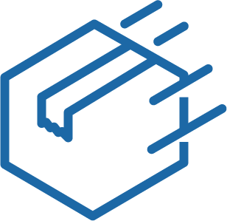

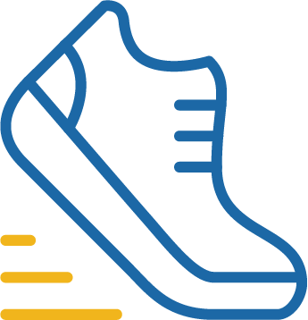
LOGO
How You Benefit
Improved response times to order inquiries
Enhanced materials and inventory visibility
Accelerated order throughput
Improved OTIF
Improved lot traceability and quality control
Ability to handle changes with ease and agility
Notes:
Slide notes:
Introduce Nulogy as your technology partner of choice for deliver superior co-packing service: “Our operations are digitally powered by a trusted technology vendor that provides the following benefits…”

Slide 7

Solution Overview

Slide 8
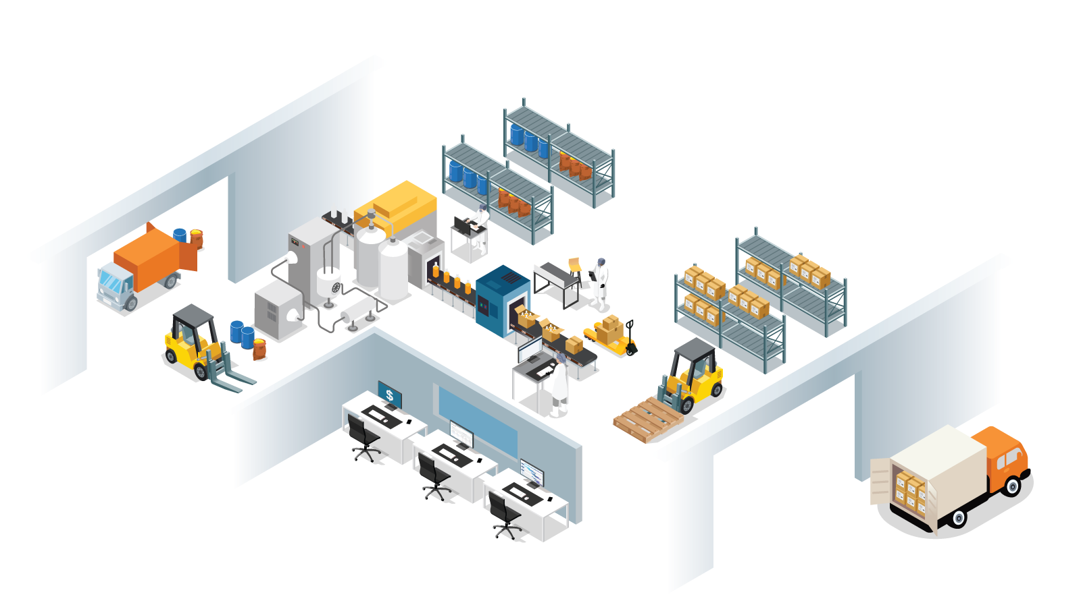


Digitally Equipped for Operational Excellence
PERFORMANCE / COSTING
Management
E2E Traceability / Compliance
PRODUCTION MANAGEMENT
Line Lead
Receiving
INVENTORY MANAGEMENT
Forklift Operator
Warehouse Management
QUALITY INSPECTIONS
Quality Manager
Quality Control
Picking
Primary Packaging
MATERIALS MANAGEMENT
Shipping & Receiving Clerk
Secondary Packaging
Planning & Scheduling
ORDER MANAGEMENT & PRODUCTION SCHEDULING
Production Manager
Costing
CAPACITY & MATERIALS PLANNING
Planners
Capacity & Materials
Planning
Shipping
Production
Scheduling
Notes:
Slide notes:
This slide is intended to illustrate how the Nulogy platform enhances every aspect of your co-pack operation.

Slide 9


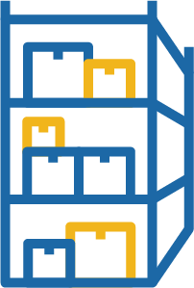
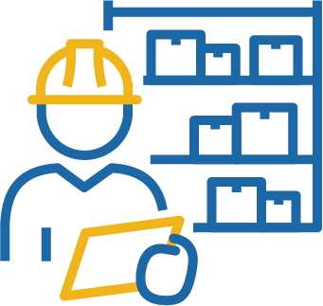



LOGO
Nulogy Shop Floor Solution
Nulogy's Shop Floor Solution empowers [name of company] to operate more efficiently and cost-effectively, all while enabling us to maintain high levels of quality, responsiveness, and service.
COSTING
MATERIALS PLANNING
WAREHOUSE MANAGEMENT
PRODUCTION MANAGEMENT
DIGITAL QUALITY INSPECTION
PRODUCTION SCHEDULING
Notes:
The Shop Floor Solution consists of the following modules, purpose-built to the complexity of co-pack operations:
Costing:
Quickly generates accurate estimates on expected costs as well as invoices directly from production or shipments, enabling you to perform granular profitability analysis and optimize line configurations accordingly.
Materials Planning:
Proactively plans the procurement WIP & ingredients based on current demand, consumption, scrap rates, lead times, inventory levels, outstanding orders and other factors, ensuring the right inventory at the right time.
Warehouse Management:
Real-time inventory visibility with warehouse guidance and system verifications to improve inventory control and accuracy, while delivering lot traceability for quick and accurate recalls among other critical warehousing functions.
Production Management:
Digitalizes shop floor processes, including backflushing and reconciliation, generating real-time dashboards such as line availability, line efficiency & others to help bolster throughput, reduce costs and unveil valuable insights.
Digital Quality Inspection:
Digitalizes quality inspection sheets on tablet devices, with e-signatures and audit trails to streamline and enforce quality control processes, helping you save time, prevent errors and release products faster.
Production Scheduling:
An intuitive, drag-and-drop based module that allows you to quickly visualize and optimize your production schedule based on various constraining factors, current demand, downtimes, run rates, and more.

Slide 10
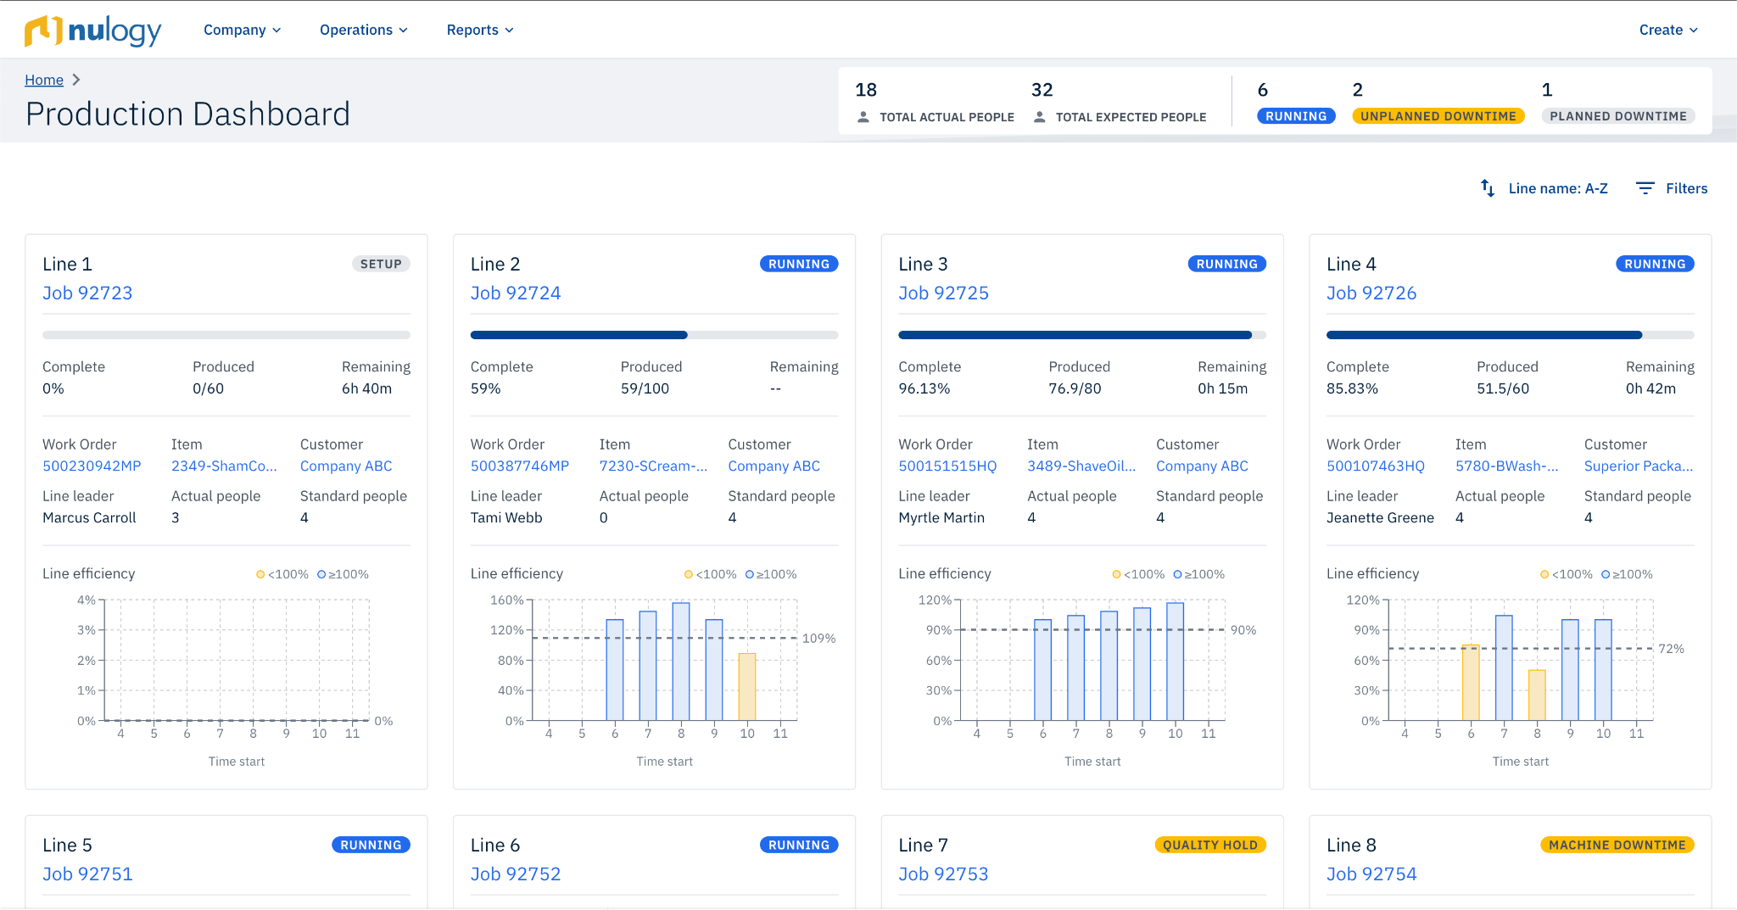
LOGO
Production Management
Our production environment is digitalized for real-time visibility and control.
Increased operational control to operate more efficiently while improving agility, quality and service levels.
Ability to monitor and optimize live production through real time dashboards.
Improves throughput, reduces costs and unveils actionable insights.

Slide 11
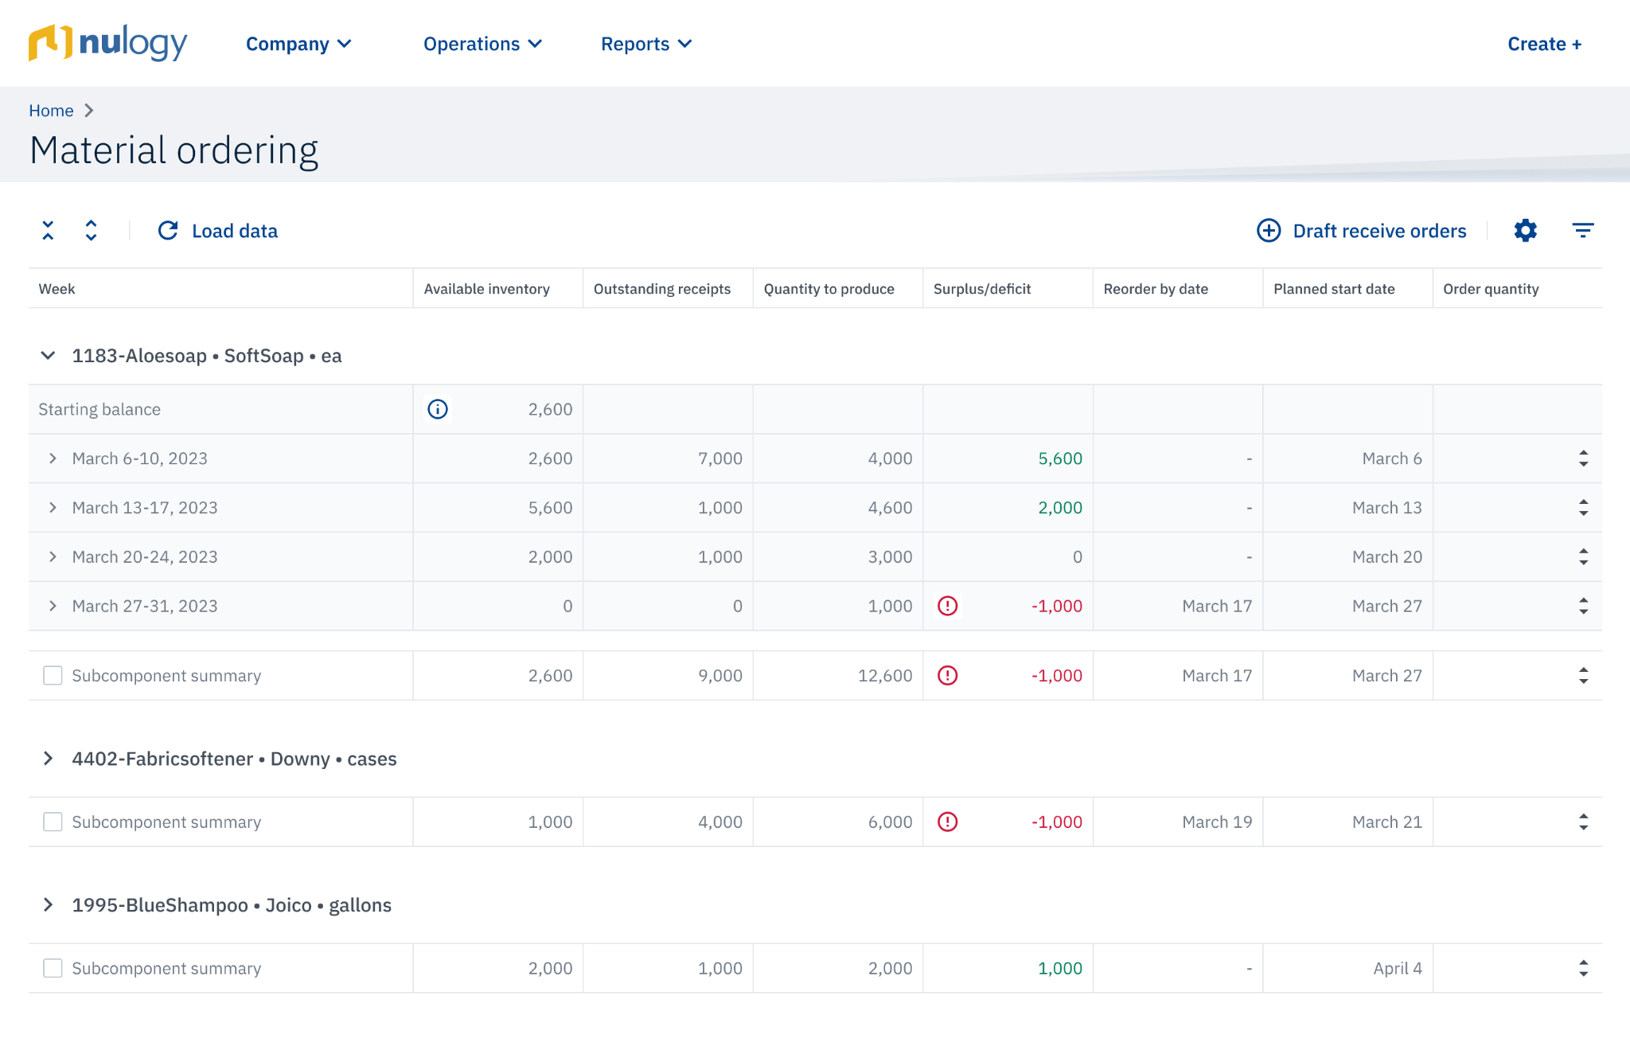
LOGO
Material Planning
We ensure the right inventory at the right time.
We can proactively plan procurement WIPs and ingredients based on current demand, consumption, inventory levels and more.
We reduce waste by ordering the right amount at the right time by leveraging accurate lead time information.
We can take proactive action by easily monitor potential future material deficients.

Slide 12
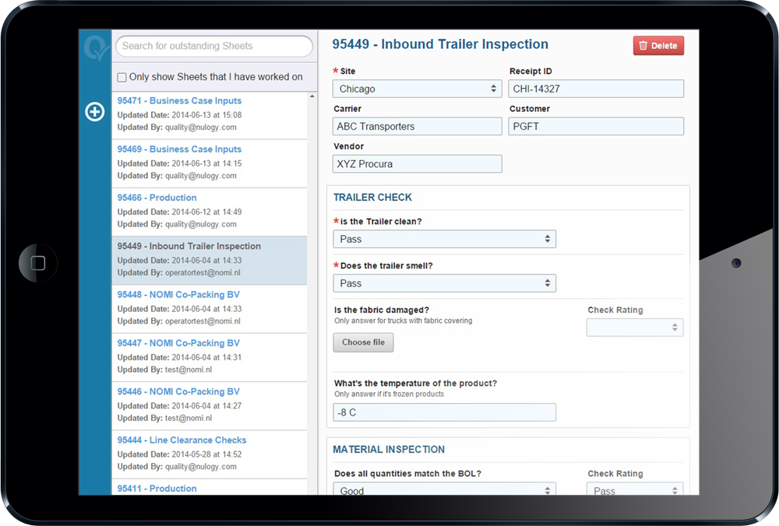
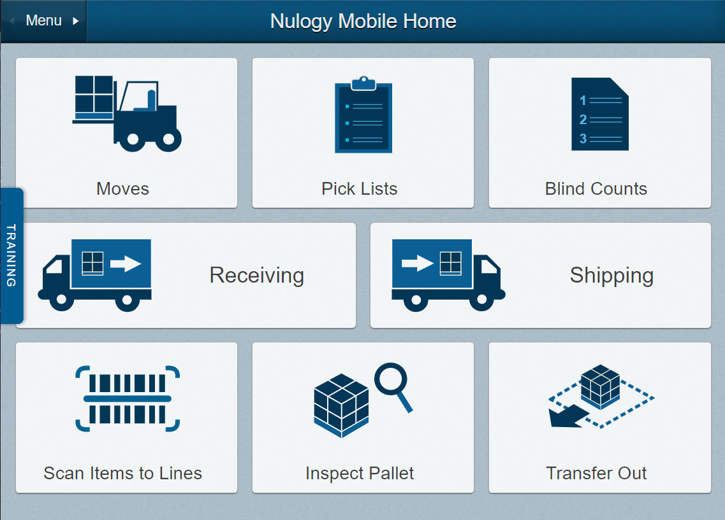
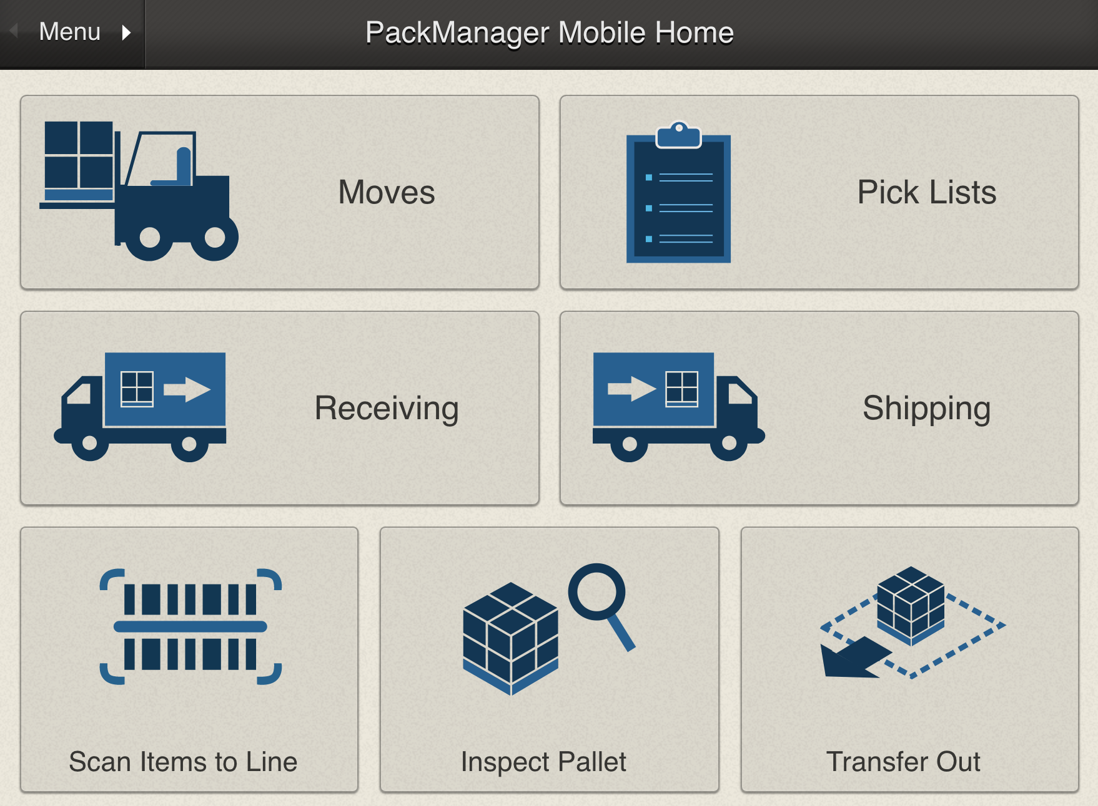
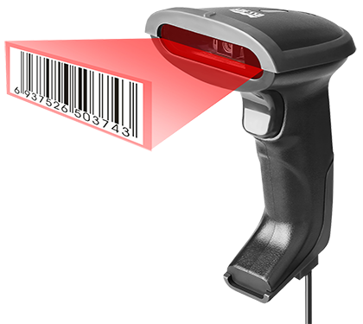
LOGO
Warehouse Management
Our warehouse is enabled with real-time inventory visibility.
Added real-time inventory visibility with warehouse guidance and system verifications to improve inventory control and accuracy.
Enabled lot code and expiry traceability for quick and accurate recalls.
We use a mobile interface to bring powerful capabilities to line leads and forklift operators.
We leverage GS1 and SSCC support for pallet tracking.

Slide 13
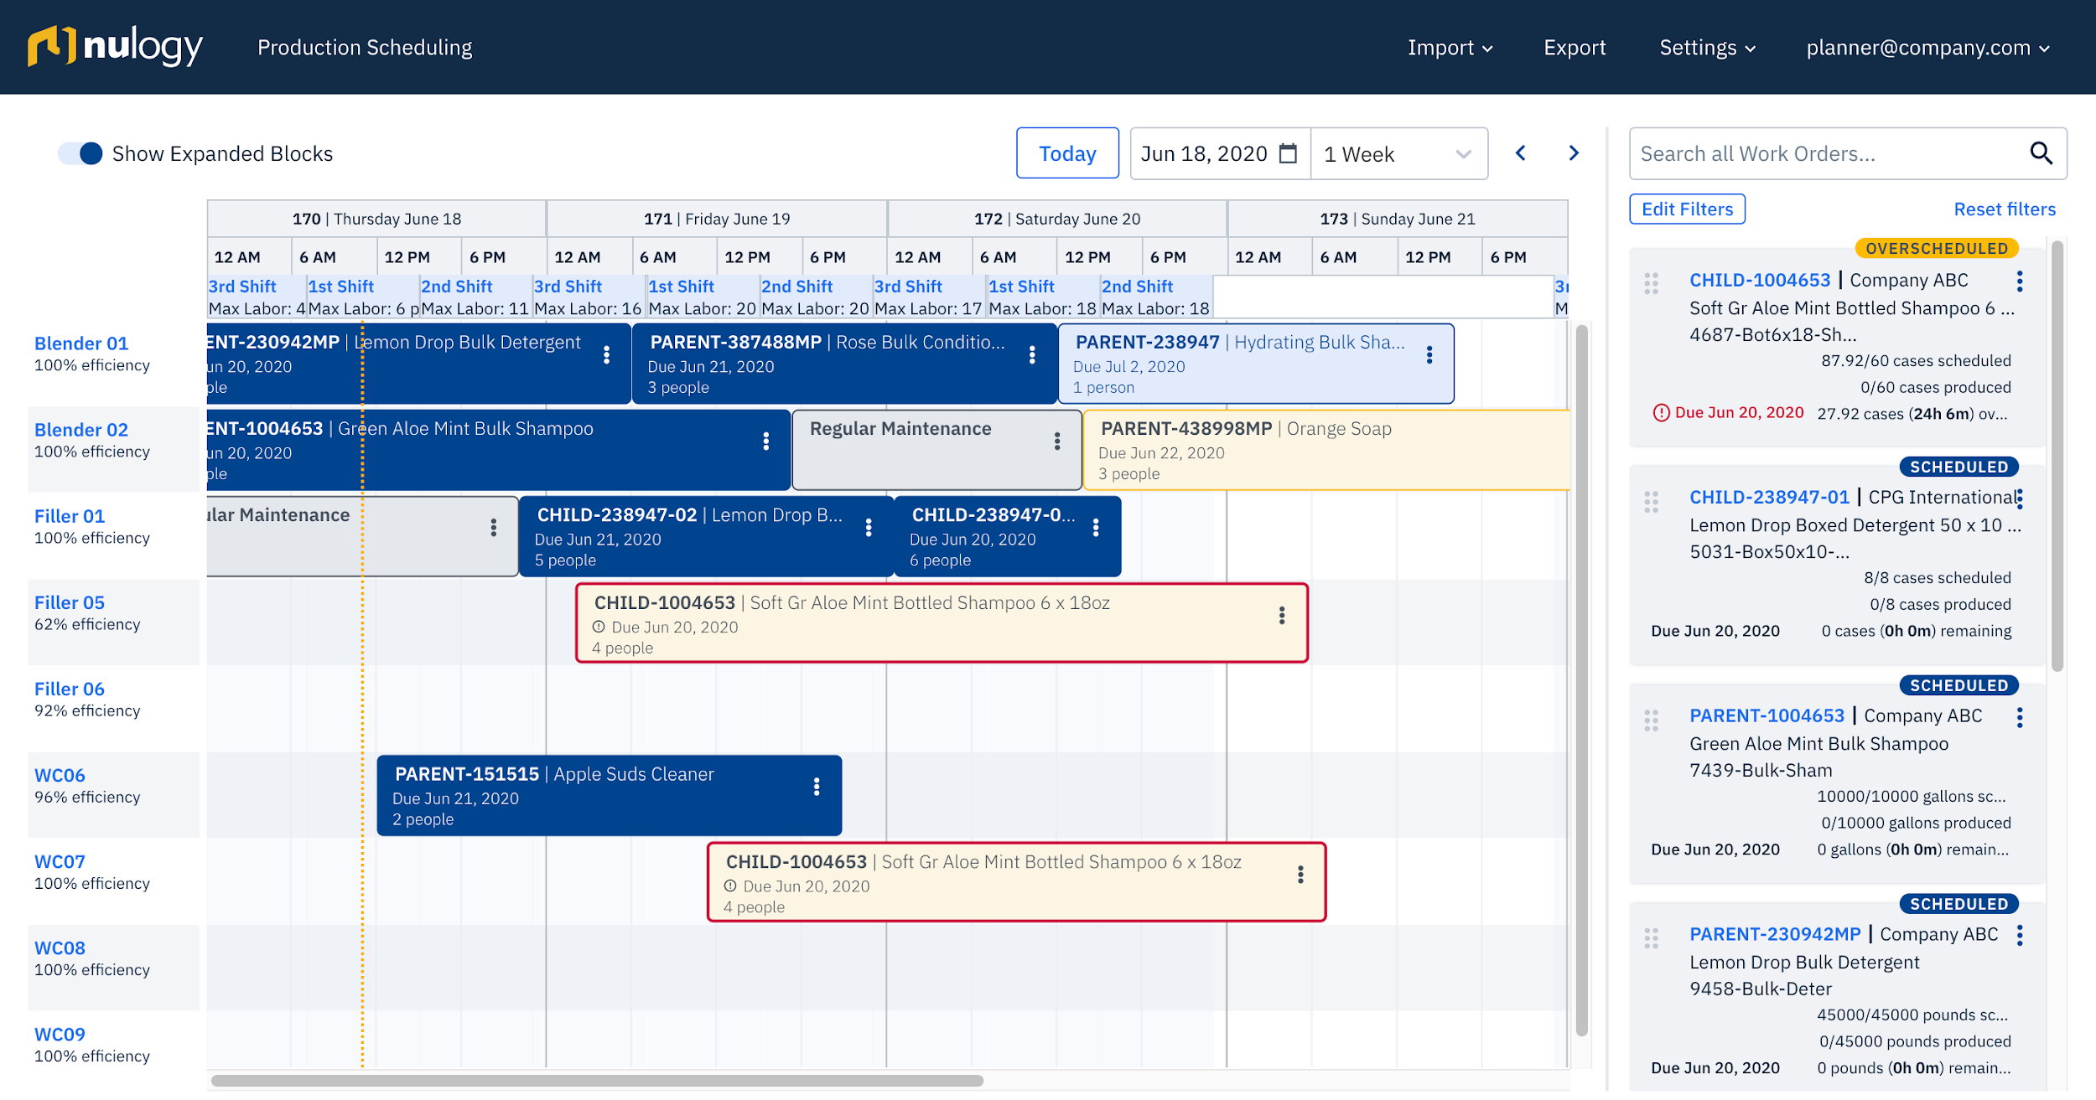
LOGO
Production Scheduling
We are empowered with intuitive, real-time production scheduling.
We can add and adjust our production schedule through a real-time visual interface.
Optimization capabilities based on demand, downtime, capacity and configurable constraints.
We can quickly re-prioritize jobs based on changing production demands.

Slide 14
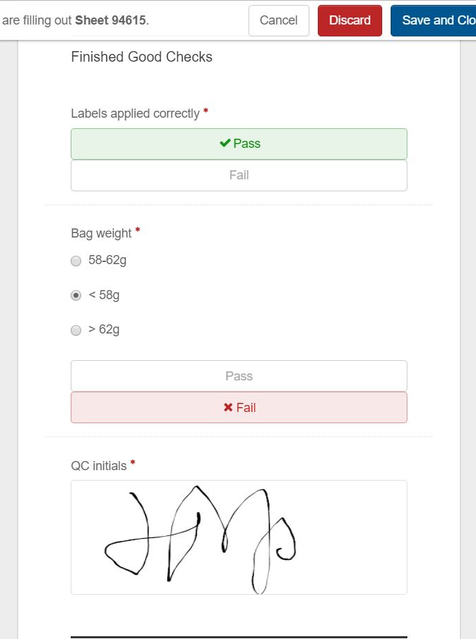
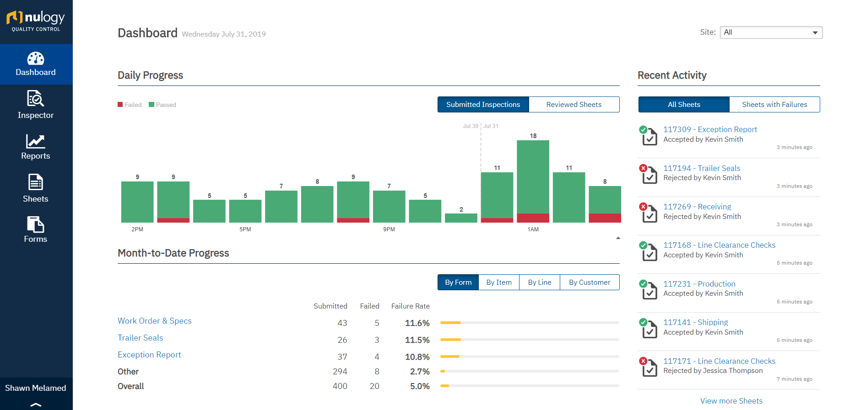
LOGO
Digital Quality Inspections
Our digital quality processes boost compliance measures and accuracy.
Our digital quality inspection sheets help streamline and enforce quality control processes, helping save time and prevent errors.
We can easily retrieve records for inspection, review and audit purposes.
We can configure electronic signature requirements for inspections.

